Slide 1
caGrid iPhone App
Iteration 1
August, 2009

Slide 2
Iteration 1 Objectives
Develop an iPhone application which can obtain a list of grid services and basic data about each service
Establish user interface layout following established principles and Apple guidelines
Validate the client/server architecture used to supply data to the iPhone client
Establish code base, source control, build processes, and basic build documentation

Slide 3
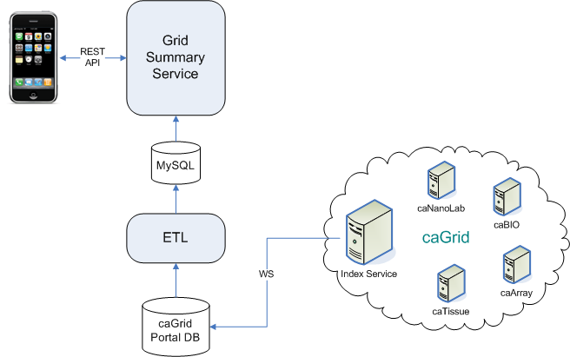
Current Architecture
GSS is a caCORE-like system
Regularly pulls data from the caGrid Portal
Custom REST API to optimize data transfer to the iPhone

Slide 4
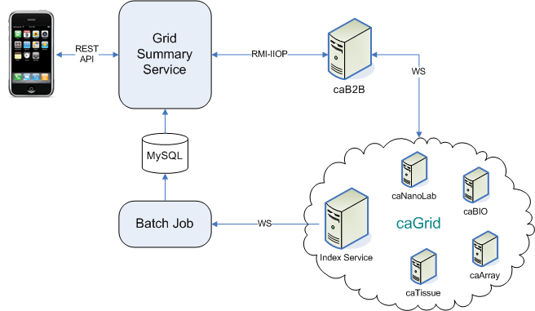
Future Architecture
Access to caB2B via EJB API for simple grid queries
Batch process to load directly from caGrid Index Service
Batch process also caches data counts from each data service

Slide 5
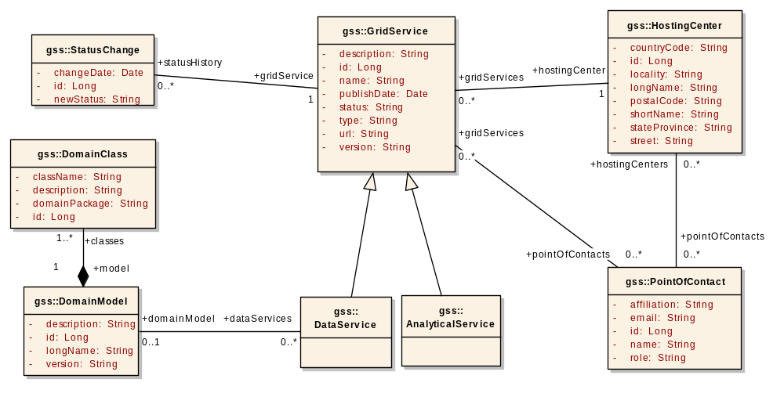
Domain Model
Model is run through the caCORE SDK to generate GSS
Currently populated with data from caGrid Portal

Slide 6
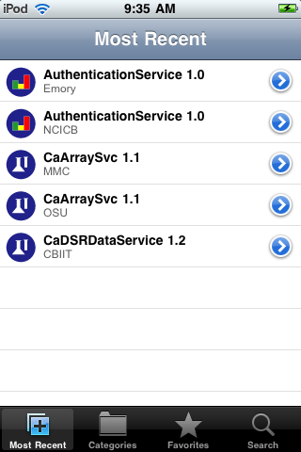
Most Recent Services
Screen organized into tabs
Initial tab shows newest services on the grid
High level summary:
  Icon + name + version + host
Icon indicates data vs analytical
Greyed out icons indicate inactive services
Detail disclosure button allows drilldown to service details

Slide 7
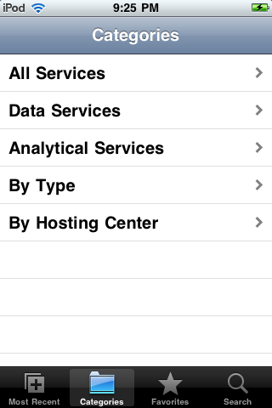
Browse Services by Category
Broad categories: all, data, analytical
“By Type” groups all similar nodes together, for example all caTissue instances
“By Hosting Center” groups services by the host’s short name
Disclosure arrow indicates a hierarchical navigation structure

Slide 8
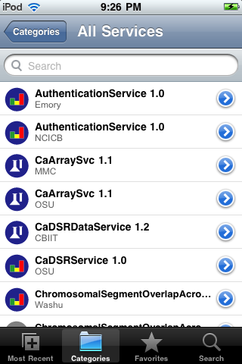
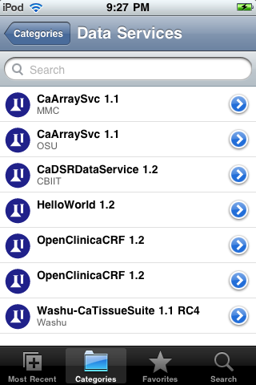
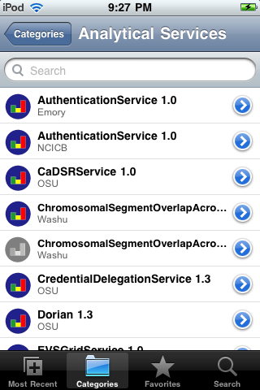
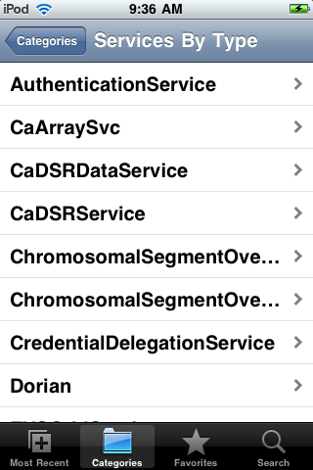
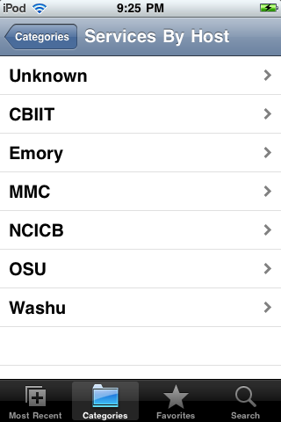
Browse Services by Category

Slide 9
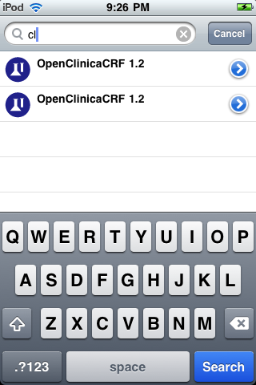
Filtering by Search Term
Filtering happens as the user types
No delay because it is done on the iPhone client side

Slide 10
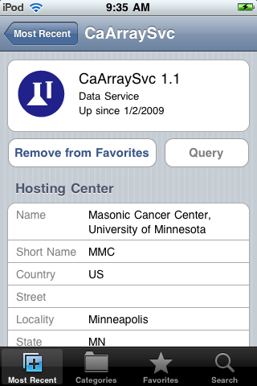
Service Details
Detail screen for a specific grid service
Top panel shows “Up since..” or “Down since..”
“Add to Favorites” button turns into “Remove from Favorites” when tapped
“Query” button currently disabled
Metadata available: hosting center, hosting center point of contact, service point of contact

Slide 11
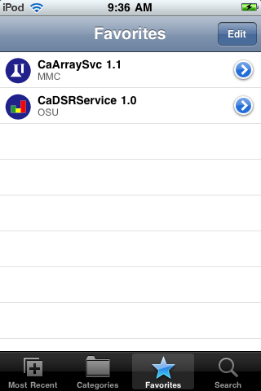
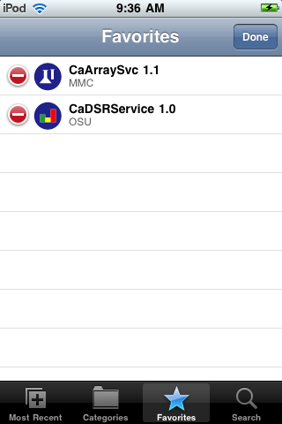
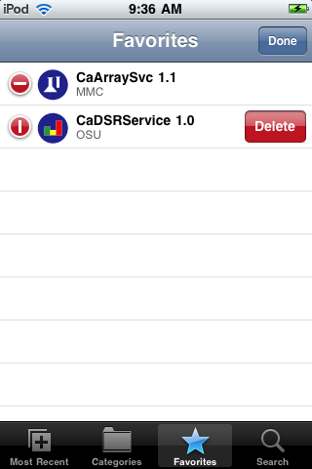
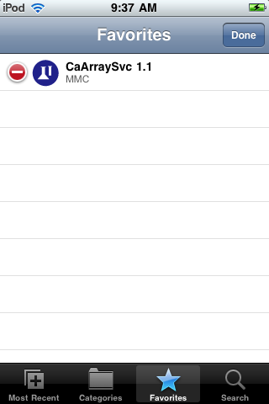
Favorite Services
Add bookmark from the service’s detail screen
Remove bookmark from detail screen, or favorites screen
Editing workflow is standardized for table views on the iPhone

Slide 12
Dev Environment
SVN Repository
  https://ncisvn.nci.nih.gov/svn/gss/trunk/software/
Dev deployment of GSS on the caB2B server:
  http://cab2b-dev.nci.nih.gov/gss10/json

Slide 13
Iteration 2 Objectives
Allow querying of certain grid services via an interface similar to the caB2B web application
Validate integration with caB2B’s EJB-based service
Design solution for handling long running queries

Slide 14
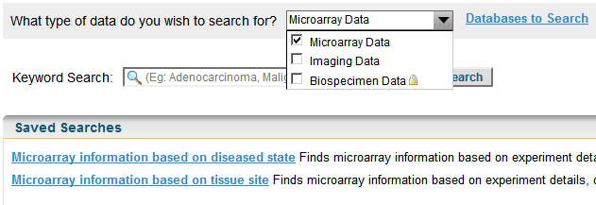
Searching for Data on the Grid
caB2B does a simple federated keyword search across all services of a given type:
  Microarray Data: caArray
  Imaging Data: NBIA
  Biospecimen Data: caTissue

Slide 15
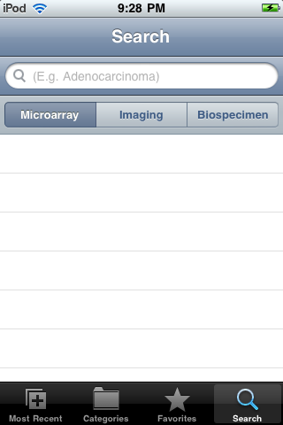
Search Tab
Based on caB2B Web Application
Choose type of data with scope buttons
Executing a search will immediately display it in the list below
But a search may take a while to run, so the results may not be available immediately

Slide 16
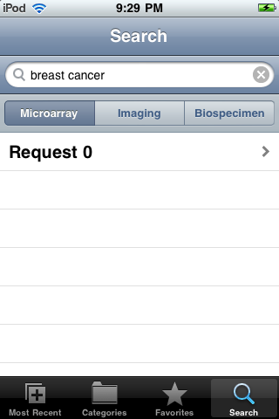
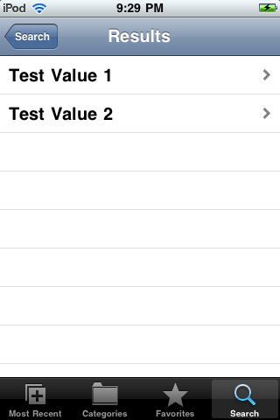
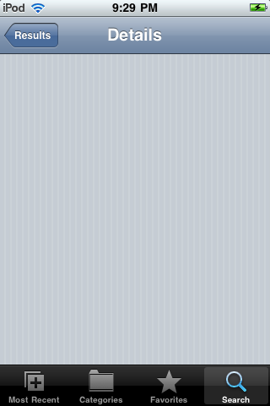
Search Results

Slide 17
Discussion

